Slide 1

Investment in opening a restaurant by population

Slide 2
Introduction/Purpose
Open a shop in the area That have the same or similar restaurant. So presenting the area That has as many foreign restaurants as I can imagine, It is Khlong Toei district.
Choosing to establish a store in the desired area according to the type of shop
Intend to allocate useful information for decision making in establishing a store There are a population of residents

Slide 3
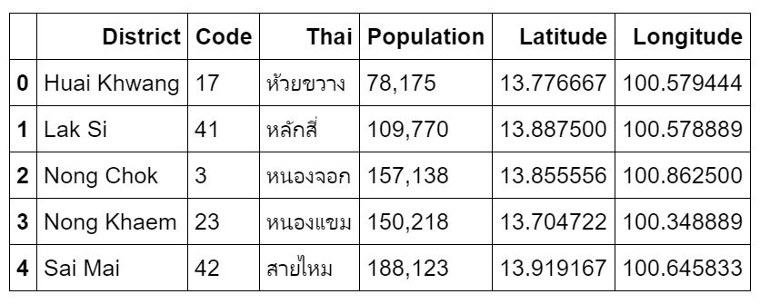
Data acquisition and cleaning
The number of residents in the area is part of the relatively important information. https://en.wikipedia.org/wiki/List_of_districts_of_Bangkok
Including image maps from the Foursquare venue categories website. https://developer.foursquare.com/docs/resources/categories
There were 50 samples around that district.
Cleaned data the result is ​​5 neighborhoods and 29 stores type.
Population in each District, Now just use only Khlong Toei

Slide 4
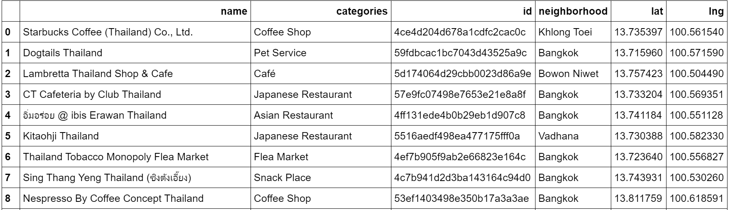
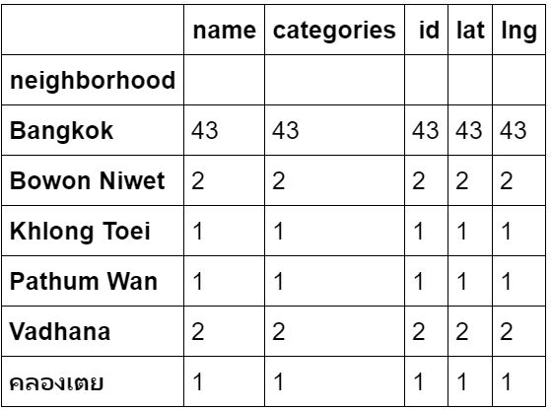
Using Replace for cleaning NaN data
After cleaning NaN value
Count the categories in each neighborhood

Slide 5
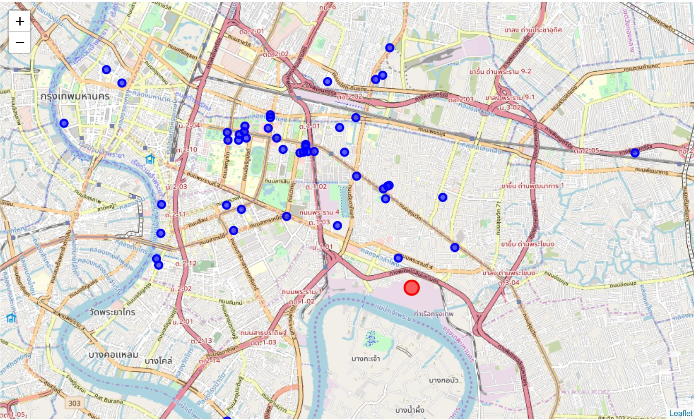
Map Visualization

Slide 6
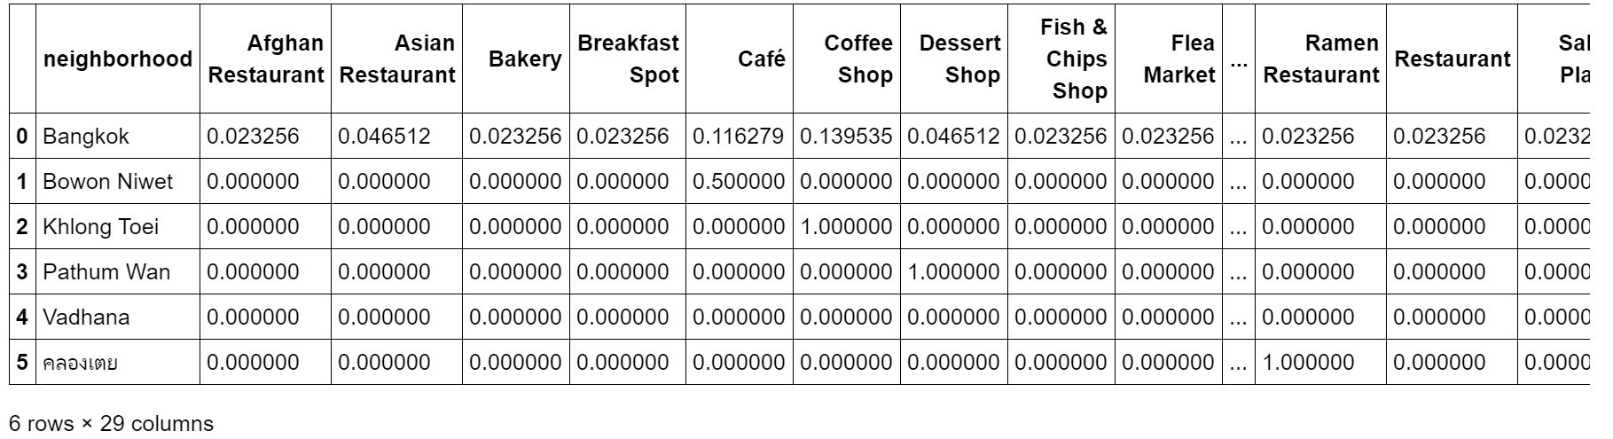
Using K-means Cluster
Preparing data to group rows by neighborhood and by taking the mean of the frequency of occurrence of each category.
The result is 6 neighborhoods and 29 stores type.

Slide 7
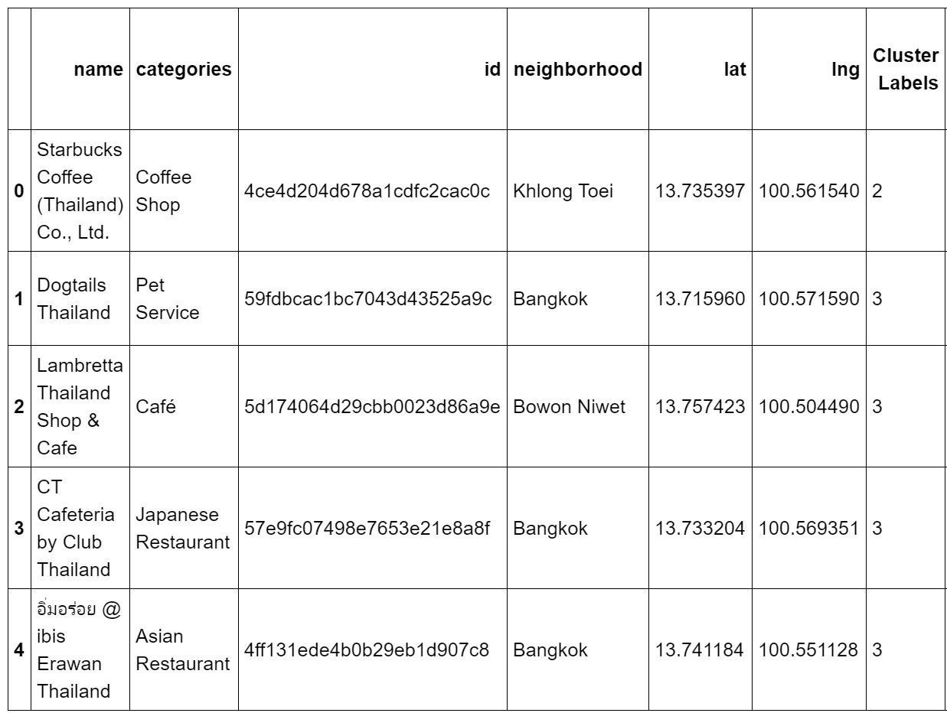
Clustering with 5 K

Slide 8
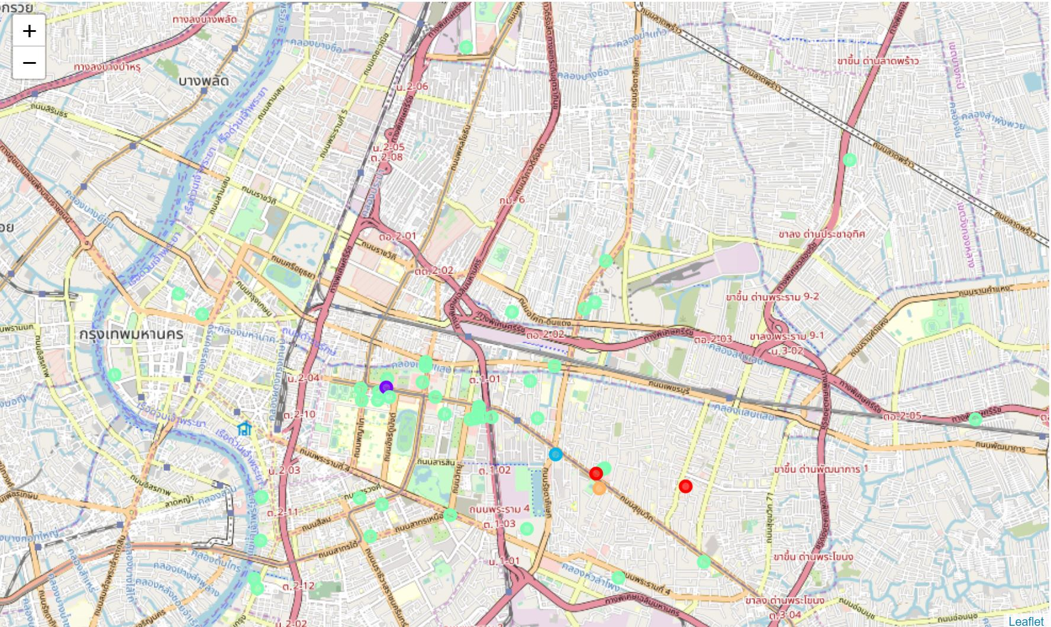
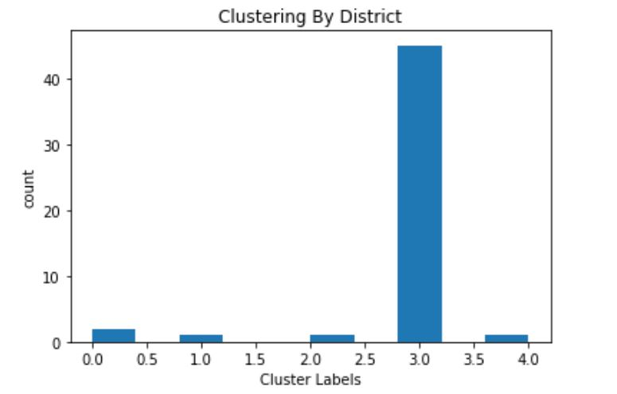
Map after Clustering
5 Groups
Khlong Toei there are many groups that are Bangkok (Group No.3).

Slide 9
Conclusion and future directions
Analyzed the groups of nearby restaurants according to each neighborhood
The most suitable for investment in those areas and can predict that the area
Develop in the interest rate of each store in order to find out whether the area is suitable for investment in opening a store
Idea include :
Need have more access account for Foursquare website (rating of resturants)
Salary of population
Electricity in each neighborhood

